Slide 1
Honour based abuse (HBA)
Overview and understanding of the current risks

Slide 2
NSAB priority context
MANAGING: Recognise the different needs and barriers to access which vary across our communities / aim to be inclusive in all aspects of safeguarding.
Imperative we recognise the very marginalised and hidden group of victims (female and male) who are at risk of HBA and Forced Marriage
All staff need to spot the signs and mobilise the right help at the right moment. There may only be one chance to save a life.
Skilled, experienced and trained staff ensure an appropriate response is offered, not just for those who have care and support needs, but to all vulnerable residents of Norfolk.

Slide 3
What is honour Based Abuse (HBA)?
“An incident or pattern of violence, threats of violence, intimidation, coercion, control or abuse (including but not limited to psychological, physical, sexual, economic, spiritual, faith-related or emotional abuse) motivated by the perpetrator’s perception that an individual has shamed, or may shame, the perpetrator, the family, or community or has otherwise broken, or may break, the perceived norms of the community’s accepted behaviours, including by speaking out about the abuse and where the perception of shame may also prevent a victim from accessing support or help.”
Karma Nirvana

Slide 4
What is honour Based Abuse (HBA)?
Motivated by the abuser’s perception that a person has brought or may bring ‘dishonour’ or ‘shame’ to themselves, their family or the community.
Can take many forms, can be complex to identify.
Centres around the idea of controlling individuals to make them behave in certain ways or subscribe to certain beliefs.
The concept of ‘honour’ is prized above the safety and wellbeing of individuals, and to compromise a family’s ‘honour’ is to bring dishonour and shame – which can have severe consequences. As a result, this can be used to justify many types of abuse, and even disownment or physical harm.
HBA is not a cultural tradition or religious practice; it is a form of abuse that can occur within any community, regardless of faith or background. Abuse is abuse – no matter who the perpetrator is or how they justify it.
Victims of HBA are 7 times more likely to be experiencing abuse from multiple perpetrators.
At least one “honour” killing occurs in the UK every month, likely to be an underestimate.

Slide 5
Why does hba occur?
HBA often occurs when perpetrators perceived a relative has shamed the family and/or a community by breaking the honour code. This is viewed as ‘dishonouring’ the family/community.
Parents who force their children to marry often seek to justify their behaviours as protecting their children, bringing strong families and preserving culture or religious traditions.
HBA cuts across all cultures, nationalities, faith groups and communities. Such abuse transcends national and international boundaries.

Slide 6
What acts are often used?
Physical abuse
Sexual abuse
Murder
Rape
Kidnap
Domestic servitude
There is no honour in these behaviours and acts, however they are conducted in the name of ‘honour’.
Like Domestic Abuse, these practices are used to control behaviours within families. The collection of practices are viewed as a means of protecting perceived cultural and religious beliefs and/or honour.

Slide 7
Seven identified scenarios
Disapproved relationship or lifestyle which opposes/threatens the cultural/community norms and expectations (‘honour’).
Threat of being taken overseas to be compelled to marry
Forced Marriage in the UK
Returned to UK and victim of a compelled/forced marriage
Forcibly/compelled marriage and is a reluctant sponsor to their spouse for the purposes of acquiring a visa
Victim on a spousal/partner visa, is married to a British national/ILR and is experiencing HBA
Victim has already fled HBA/Forced Marriage.

Slide 8
Why are we seeing an increase?
Changing local demographics:
  Refugee resettlement (UKRS, ARAP, ACRS).
  Higher numbers of asylum seekers and grants of refugee status.
  Family reunion visas granted to those with Refugee Status/Humanitarian Protection.
  Spousal/Partner visas granted to those with ILR/Settlement, making such sponsors a valuable commodity.
  Increase of Skilled Worker visas (particularly in Health and Social Care sector) to replace the loss of workforce following Brexit.
  Increased diversity of local population.
Increased awareness and staff training

Slide 9
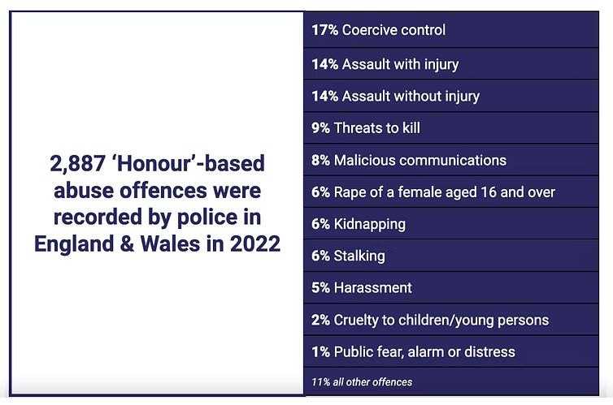

Slide 10
Norfolk ASSD use of HBA & forced Marriage Risk assessment
Karma Nirvana developed HBA/FM Risk Assessment tool
2 PFAT SWs completed the Karma Nirvana HBA/FM Risk Assessment training in October 2024
Since completing this training, 15 HBA Risk Assessments completed by PFAT
Development of the HBA & FM Risk Assessment Tool on LAS, went live 01.04.2025. This will give us a greater degree of analysis and data by the end of the current financial year.

Slide 11
One chance
There might only be one chance to save the life if a person who is at risk of Honour-based Abuse and other harmful practices, such as Forced Marriage, FGM, Virginity Testing, Breast-flattening/ironing, Conversion Therapy or being punished or harmed in any way for not conforming to family or cultural beliefs.
A victim may have only one chance to disclose they are in danger.
If the victim is not listened to or taken seriously, they will walk away without help. That one chance might be lost and their life lost too.

Slide 12
One chance – dos and don’ts
Do Not
  Send them away
  Speak to them with family members present or within the home
  Approach members of the family or wider community
  Attempt mediation or reconciliation with the family and/or community members
  Share information without consent
Do
Speak to the person immediately and on their own.
Speak in a private place where you will not be overheard.
Use a qualified, independent interpreter, if required (INTRAN)
Listen to them and believe them
Reassure them they can speak to you in confidence
Recognise and respect their wishes
Get immediate advice from PFAT or Police HBA team

Slide 13
Actions for Business group & nsab
Staff training / awareness
Should we be considering bringing in external training?
Confirming the referral routes.
Training for SCCE staff
Analysis of data in 12 months.
Adopt “One Chance” policy on HBA.
Seek recommendation from NSAB to identify resources to deliver frontline support [staffing, accommodation, subsistence support].
How do we make sure HBA work doesn’t get lost?

